Slide 1

BEYOND THE VIEWS:
DECODING YOUTUBE TRENDS WITH ANALYTICS AT SCALE
BY GROUP 2:
MOULESH MANIKANDAN
JINAL MEHTA
SUPRIA DEKA
NAVTEJ RANDHAWA
MOHAMMAD ABED

Slide 2
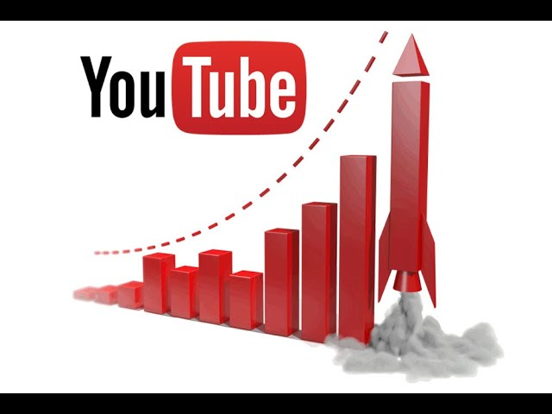
PROBLEM STATEMENT & MOTIVATION
YouTube receives millions of views and uploads per day — making it a massive data source. Manual or local computation can't handle this scale, especially for multi-country datasets.
Why analyze Youtube trends at scale?
Need to answer key questions:
What makes videos trend?
Which creators dominate?
How do countries differ in engagement?
And so on

Slide 3

METADATA
The dataset consists of trending YouTube video metadata from multiple countries (US, IN, GB..)
Covers various attributes per video, such as:
- title, channel_title, category_id, publish_time
- views, likes, dislikes, comments
- description, tags, trending_date
Category mapping performed using JSON-based lookup tables
Total Records after processing - ~130,000 rows
Time Frame - ~ 2 years of data from 2017-2018

Slide 4




INFRASTRUCTURE SETUP
Amazon S3: Storage for YouTube datasets (CSV + JSON)
AWS EMR Cluster: Spark cluster with auto-scaling capabilities
EC2 Machines: Distributed worker nodes across cluster (6 machines)
Master Node: Coordinates tasks, DAG scheduling, resource allocation
JupyterHub: Runs inside EMR master node for PySpark development
Spark on YARN: Resource-efficient distributed execution

Slide 5
EMR SCALING – OUR CLUSTER IN ACTION
We simulated two load scenarios using PySpark:
Small Load: 2 countries data (US, IN) ~ 80k records
Large Load: 4 countries data (US, IN, GB, JP) ~160k records
Observed Performance Gains:
LOADING CAPACITY | LOAD TIME (Seconds) | PROCESSING TIME (Seconds)
Small Load(~80k records) | 1.48s | 0.51s
Large load(~160k records) | 2.34s | 0.69s
- Used Spark’s .repartition(100) to distribute processing across the cluster
- Amazon EMR auto-scaled by distributing tasks across multiple EC2 worker nodes
- Achieved parallelism without changing our code – thanks to Spark

Slide 6
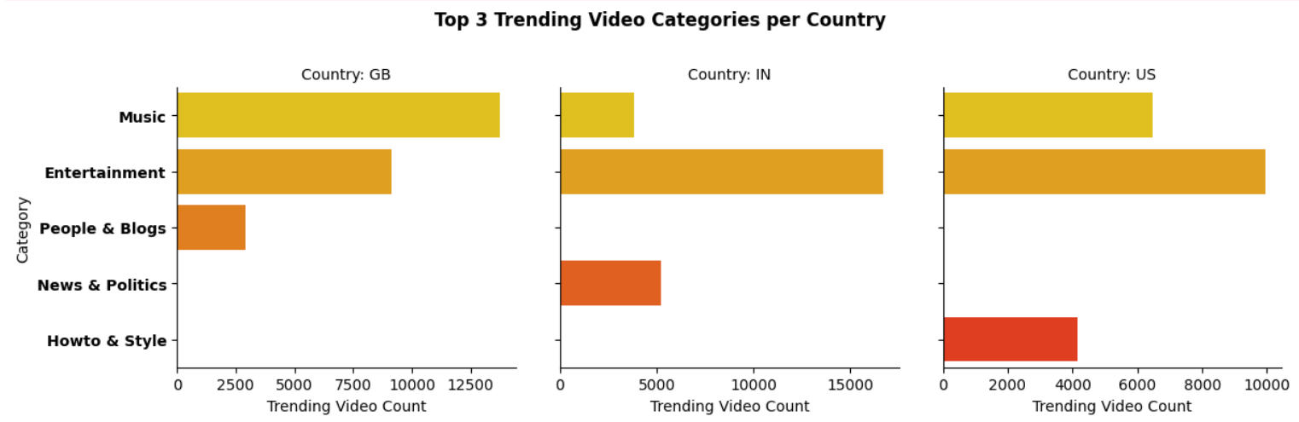
TOP 3 TRENDING CATEGORIES PER COUNTRY
Used: groupBy, countDistinct, orderBy, filter, select
Insight
IN: Entertainment dominates significantly
GB: Music is the top trending category
US: Balanced popularity between Entertainment and Music
Recommendation
Localize content strategy: YouTube should prioritize Music partnerships in GB, Entertainment-focused monetization in IN, and dual-category campaigns in the US.

Slide 7
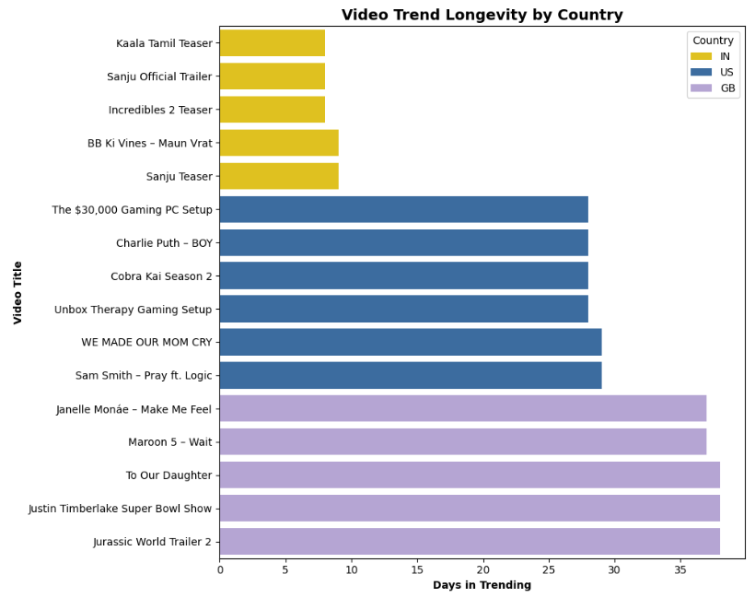
VIDEO TREND LONGEVITY BY COUNTRY
Insight
GB videos tend to trend for 30+ days, especially emotional or entertainment-driven content
US has mid-range longevity (~25 days), while IN shows quicker trend cycles (~5–8 days)
Recommendation
Focus on long-form or series-based content in GB markets and Consider regional notification/promotion strategies based on trend lifespan

Slide 8
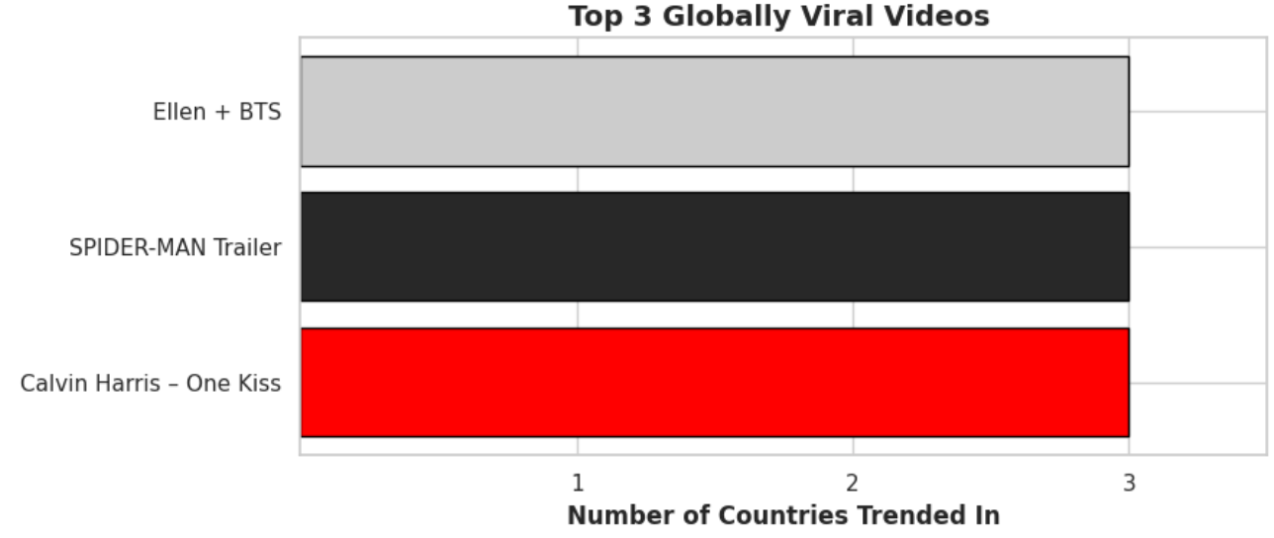
GLOBAL VIRALITY & ENGAGEMENT RATE
(Likes + comments) / (views)
Insight
Only a few videos trended across all 3 countries – showing limited cross-market virality
Insight
IN has the lowest average engagement rate (~2.5%), while US and GB hover near 3.8%–3.9%
Recommendation
localize engagement strategies
For viral potential, target universal genres like music/Trailer
Recommendation
Focus on increasing engagement in INDIA
via creator education and better content suggestions
Notes:
"Now that we’ve seen how content types and trend cycles differ across countries, let’s dive into how well content performs globally and how audiences actually engage with it.“
Virality Limitation: “Despite global access, very few videos went viral in all 3 countries — highlighting limited cross-market virality.
Engagement Analysis: “Interestingly, India showed the lowest engagement rate (~2.5%), even though it often contributes high view counts.

Slide 9
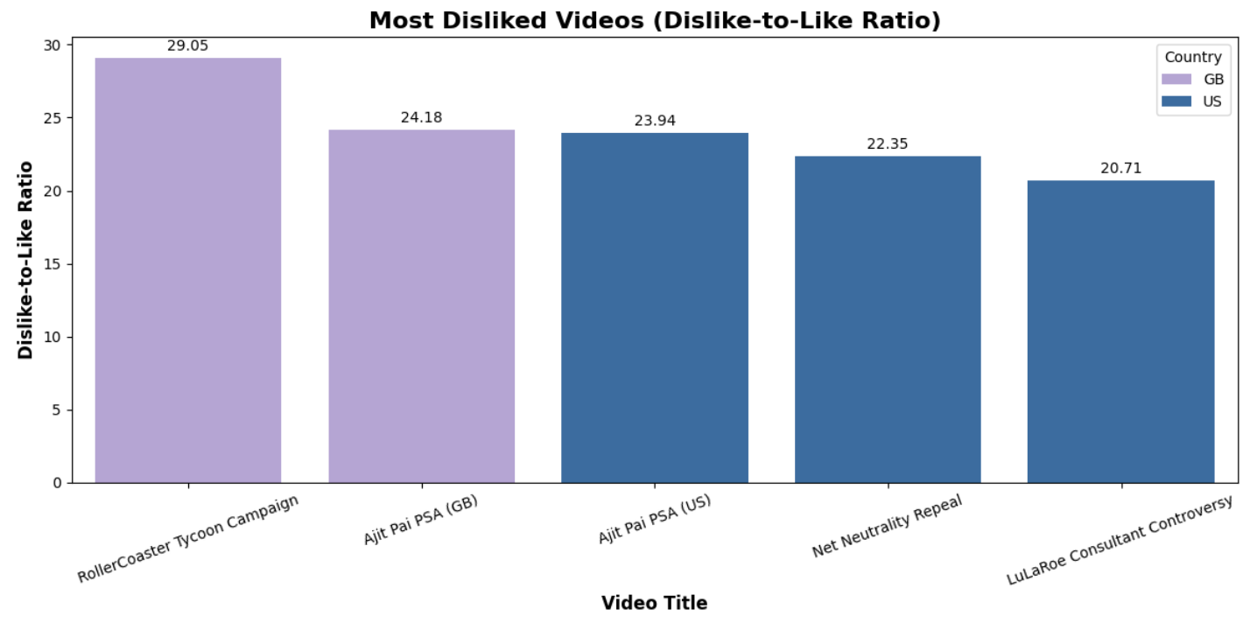
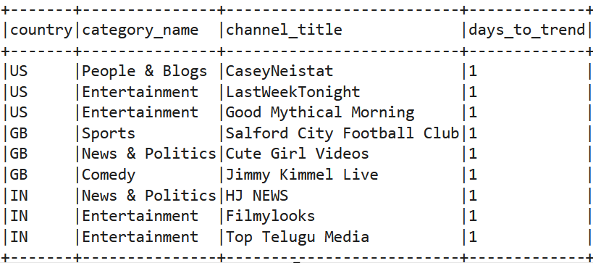
DISLIKE-TO-LIKE & FASTEST-TRENDING CREATORS
Insight
High dislike-to-like ratios seen in campaign or controversial content (e.g., ad backlash)
Insight
Creators like Casey Neistat, Top Telugu Media, LastWeek Tonight trend fastest — often due to timely or community-driven uploads
Recommendation
Company/brands need to be aware about risk element of controversial content
Recommendation
Support fast-trending creators with feature placements or early monetization boosts
Notes:
"While virality is one side of the coin, sentiment and creator strategies often dictate whether that virality is positive or negative."
Dislike Ratios: “Campaigns and controversial content saw the highest dislike-to-like ratios — a clear indicator of backlash potential.

Slide 10
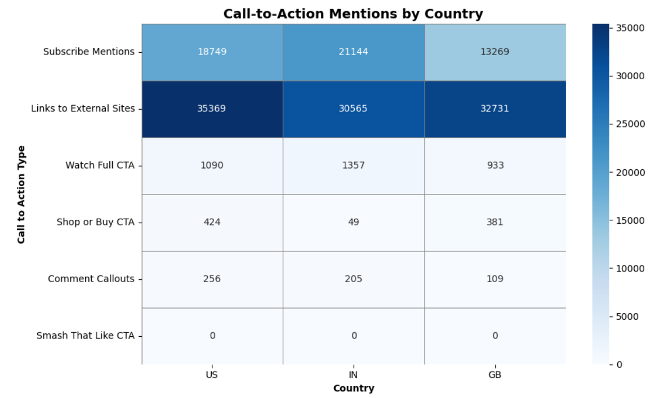
CALL-TO-ACTION MENTIONS BY COUNTRY
Insight
External link CTAs (e.g., “http”) are the most used promotional tactic across all analyzed countries.
India leads in “Subscribe” CTAs, signaling a stronger push for audience growth.
“Smash that like” is notably absent—likely used more in video speech than in text
Recommendation
Encourage CTA optimization by surfacing best practice tips in YouTube Studio, especially for descriptions.
Introduce localized CTA templates or phrase suggestions to help creators align with regional audience behavior.
Explore AI-based CTA boosters that adapt based on engagement trends in each region.

Slide 11
CONCLUSION AND FUTURE SCOPE
Takeaways:
Spark + EMR is a powerful combo for real-time, scalable analytics
Analyzed trends across countries, creators, timings, and engagement
Demonstrated end-to-end distributed data science
Future Scope:
Add sentiment analysis using Spark NLP
Predict trending videos using ML models in PySpark
Real-time ingestion using Kafka + Spark Structured Streaming

Slide 12

Thank You!

